Slide 1

House Price Prediction
GitHub Link : -
https://github.com/Meg-Megnath

Slide 2

Problem Statement:
Use Regression Analysis to predict the price of a property.

Slide 3
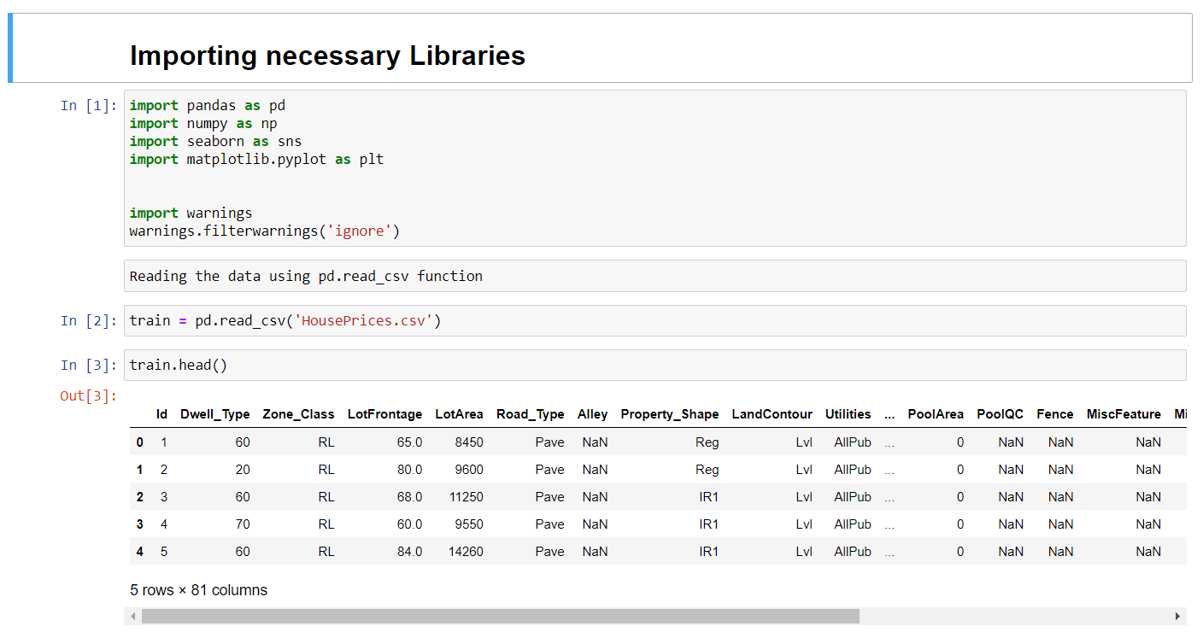
Step 1:
Importing essential libraries to understand the dataset

Slide 4

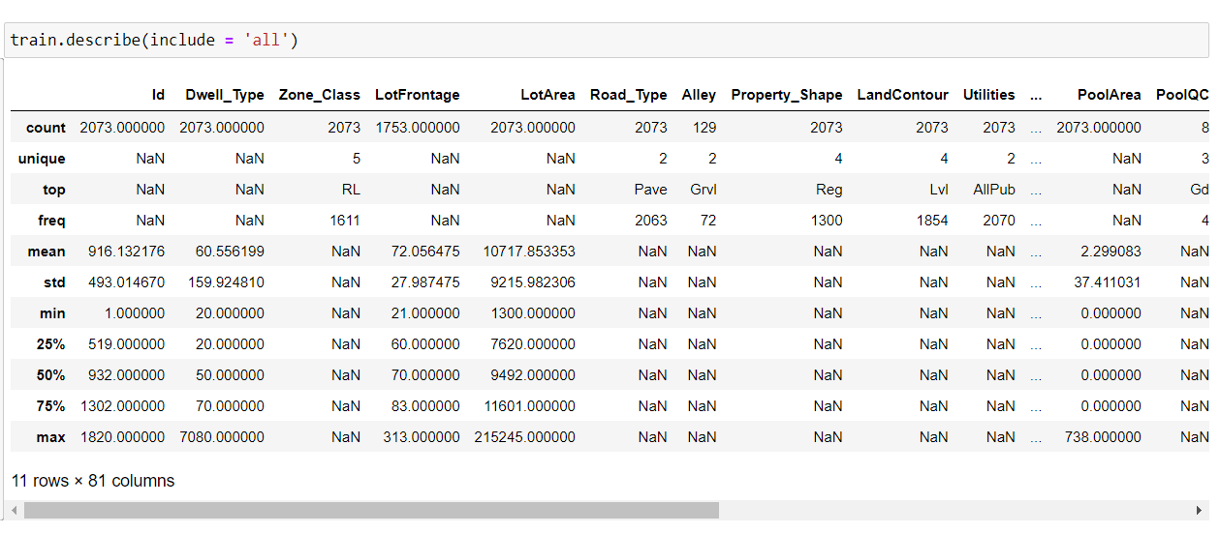
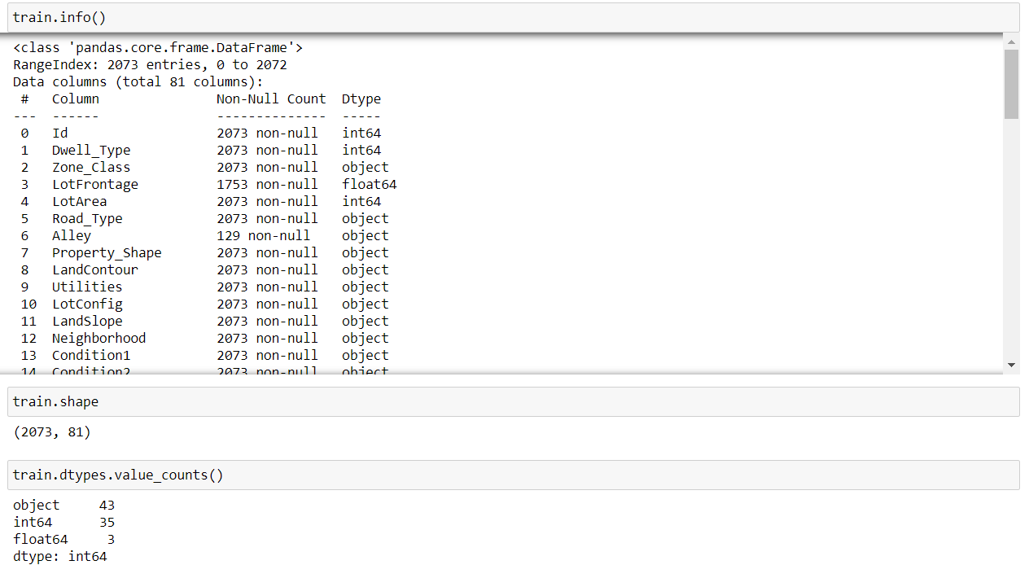
Lets understand more about the dataset
Points that are to be considered.
We are not dealing with huge dataset.
There are only 2073 rows with 81 columns.
Amongst those 81 columns.
There are 43 object datatype columns,
followed by 35 int64 and 3 float.

Slide 5
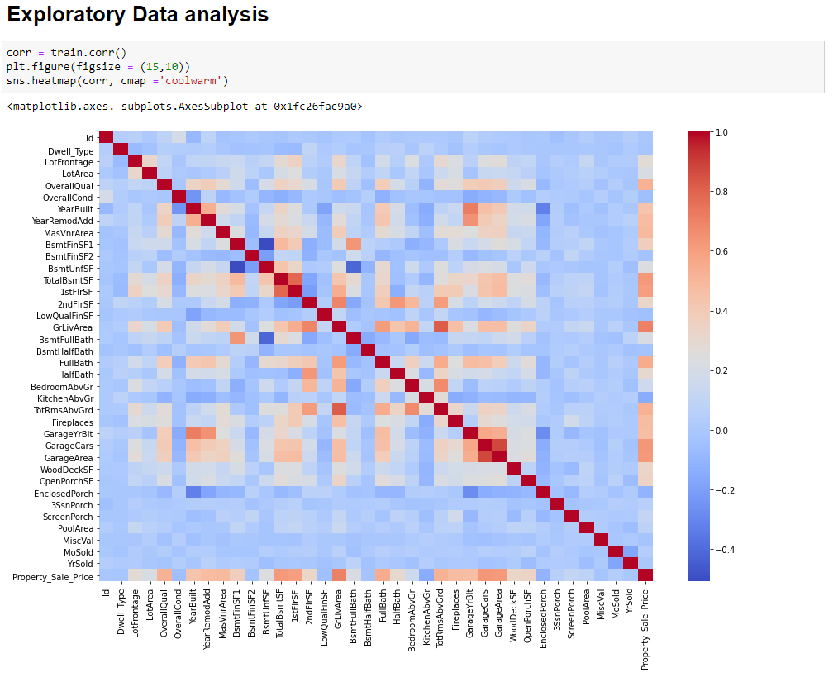
Lets visualize the data
Step 2:
Exploratory Data Analysis
Understanding the Correlation Matrix
We can observer that there exist a multicorrelation between variables.
TotalBsmtSF and 1stFlrSF
GarageCars and GarageArea
GarageYrBlt and YearBuilt
TotRmsAbvGrd and GrLivArea.

Slide 6
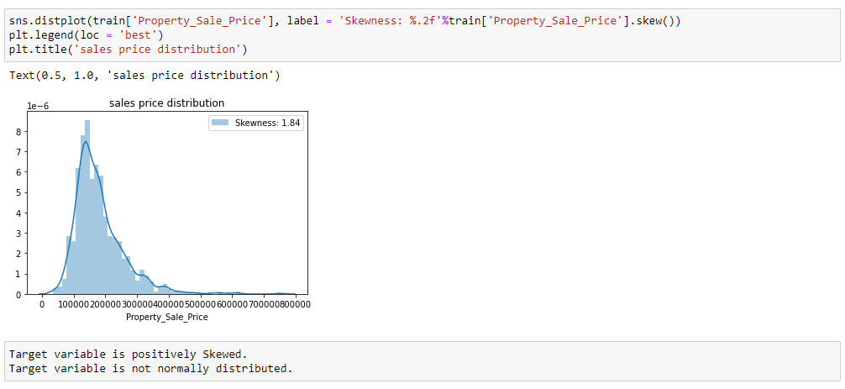
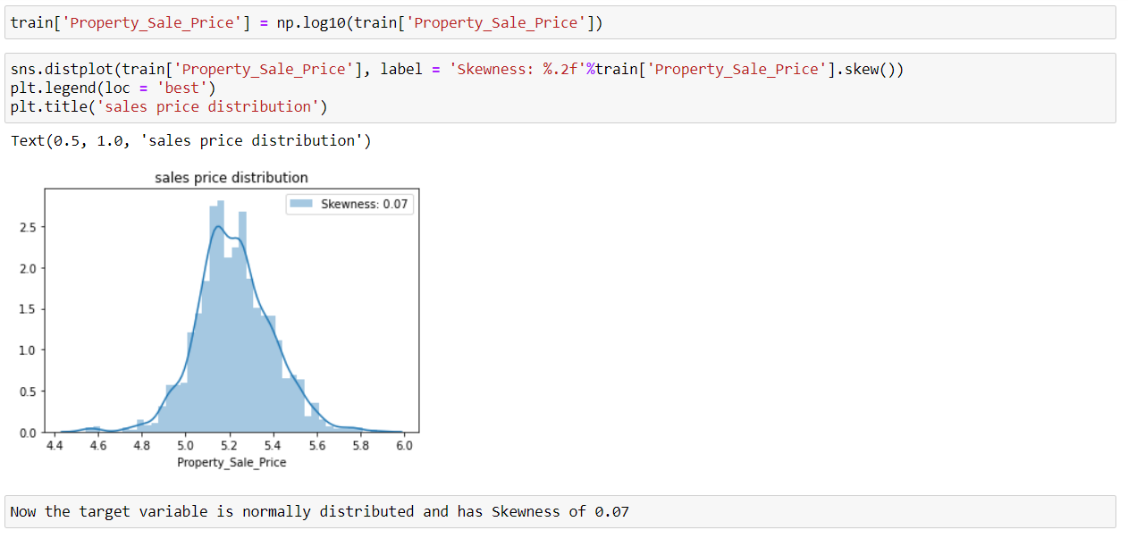
Now lets visualize and understand the dependent variable
Original Data with Skewness of 1.84
Data after log10 transformation with Skewness of 0.07

Slide 7
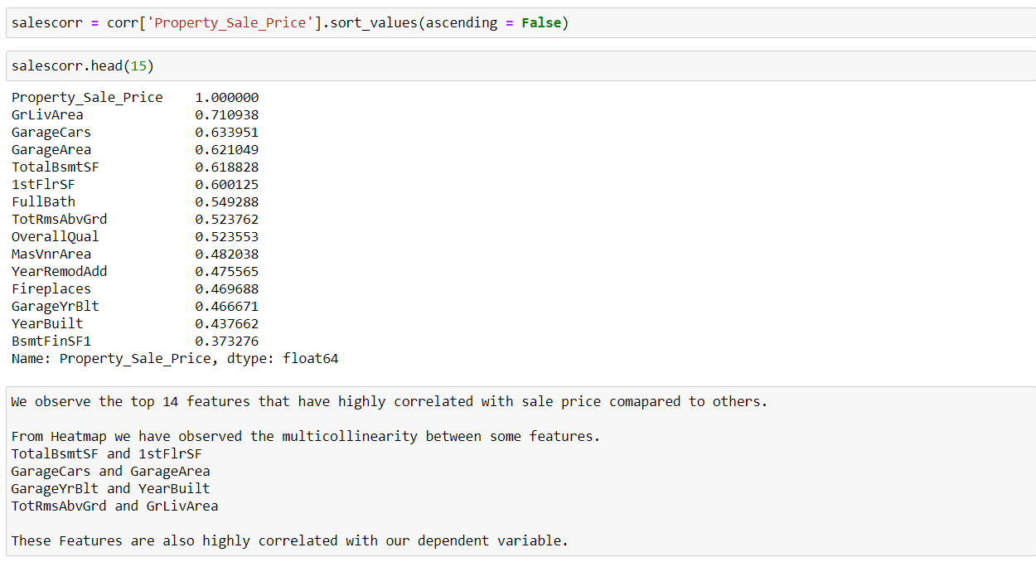
Viewing and understanding the variables which are highly correlated to dependent variable

Slide 8
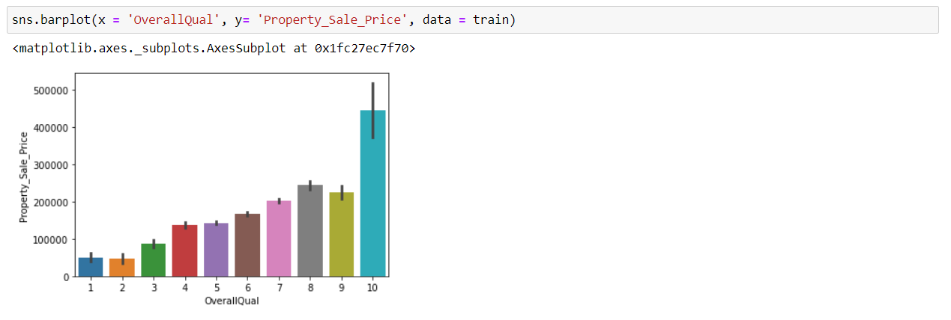
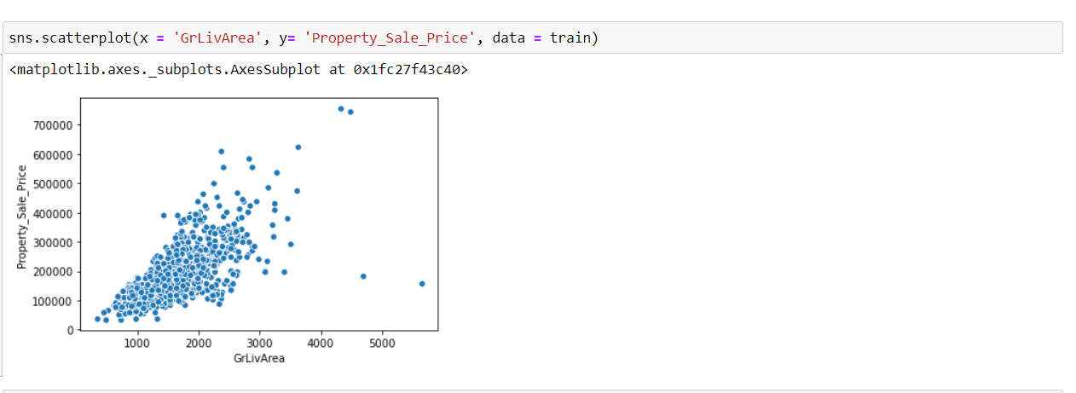
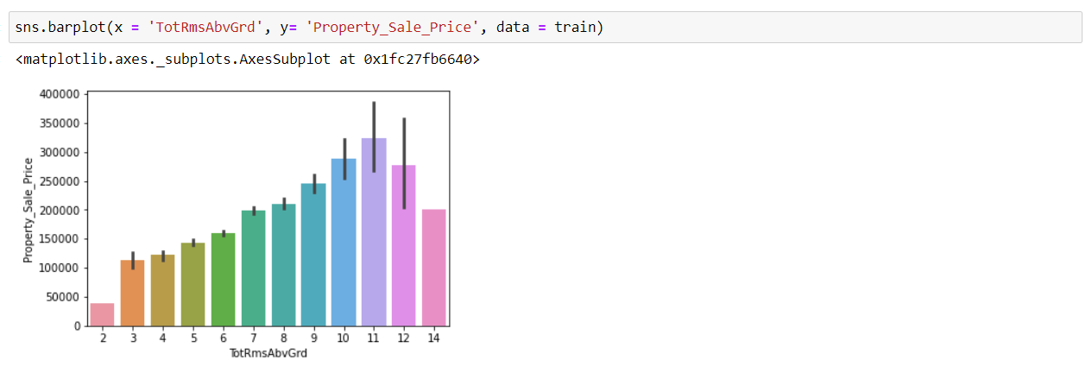
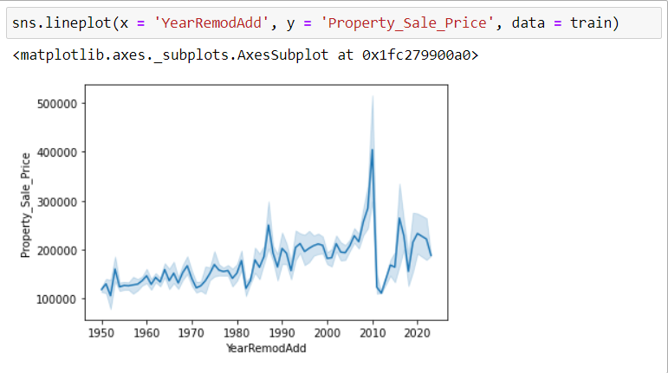
Plotting the variables that are highly correlated with dependent variable
I have used multiple-Plots to visualize the data. Visit my notebook to view more.

Slide 9
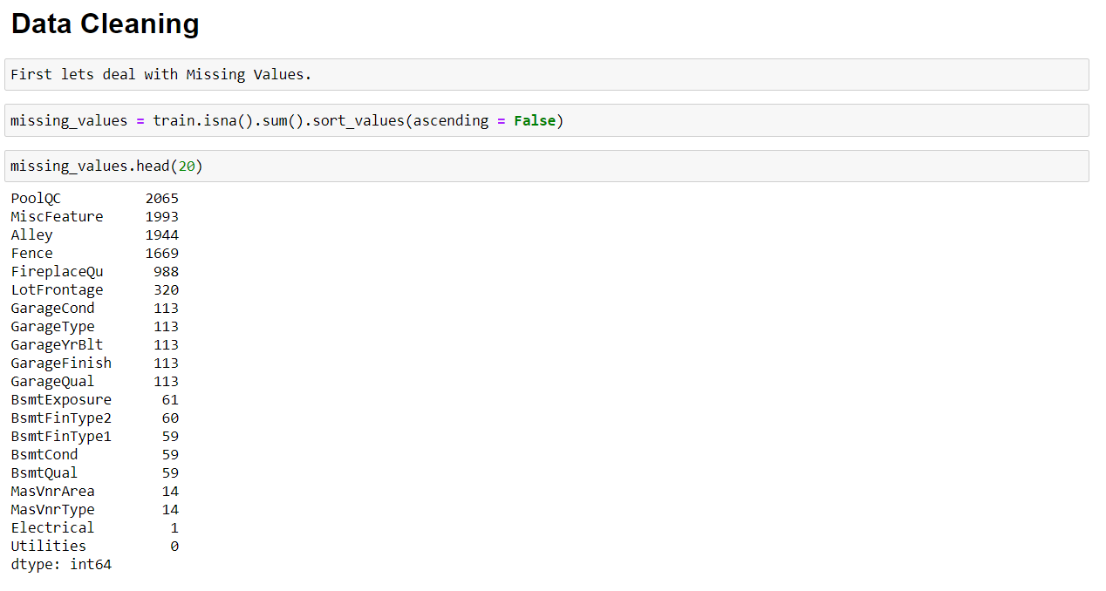
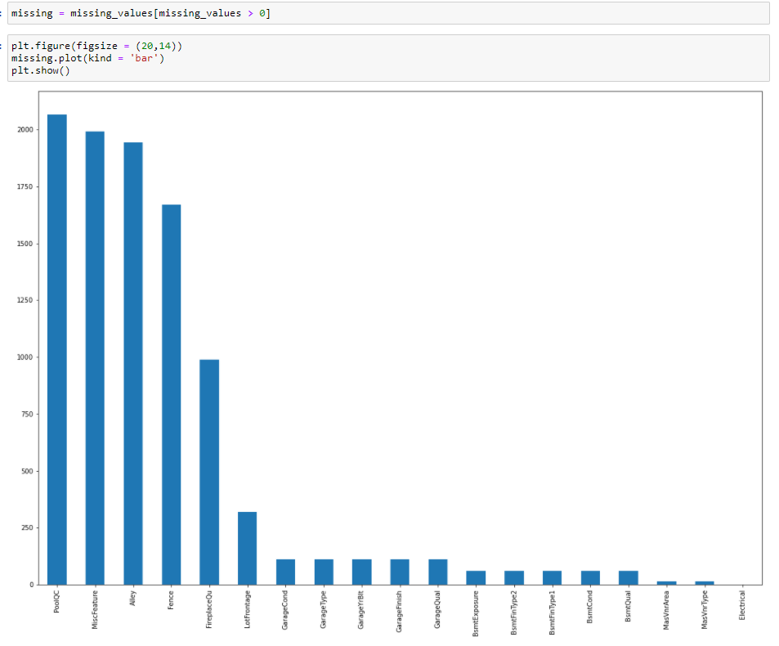
Step 3:
Identifying Missing Values

Slide 10
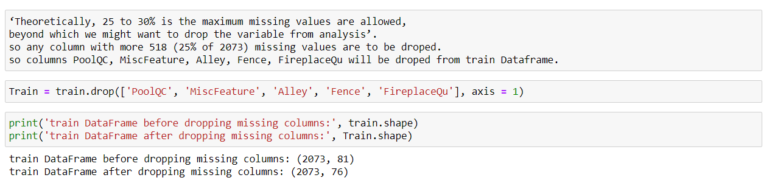
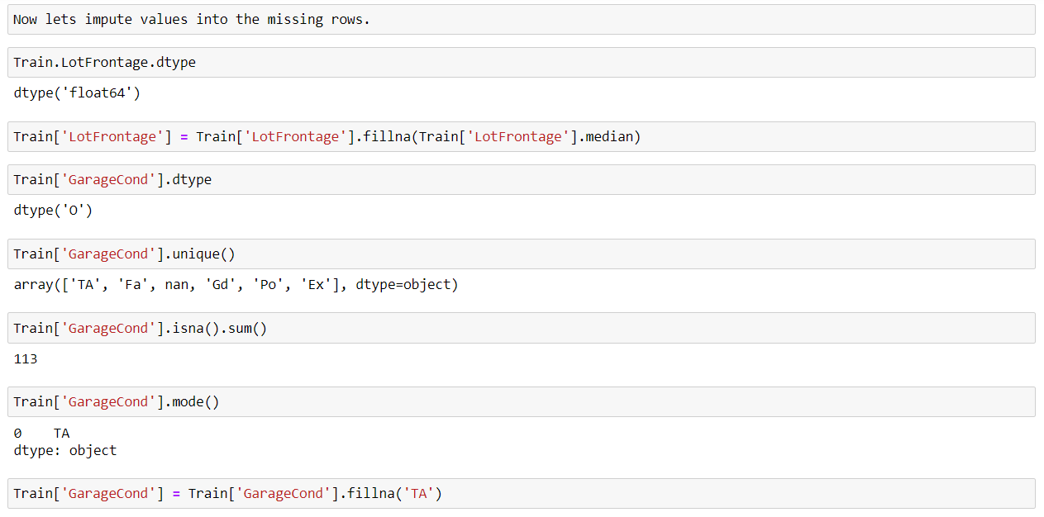
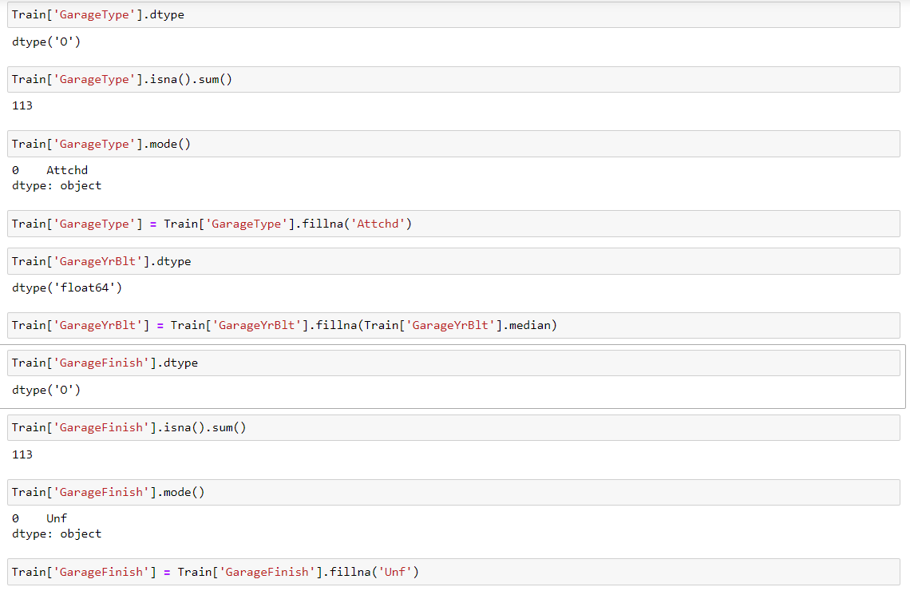
Dropping the columns which have more that 25% of missing data
Imputing values into remaining columns

Slide 11
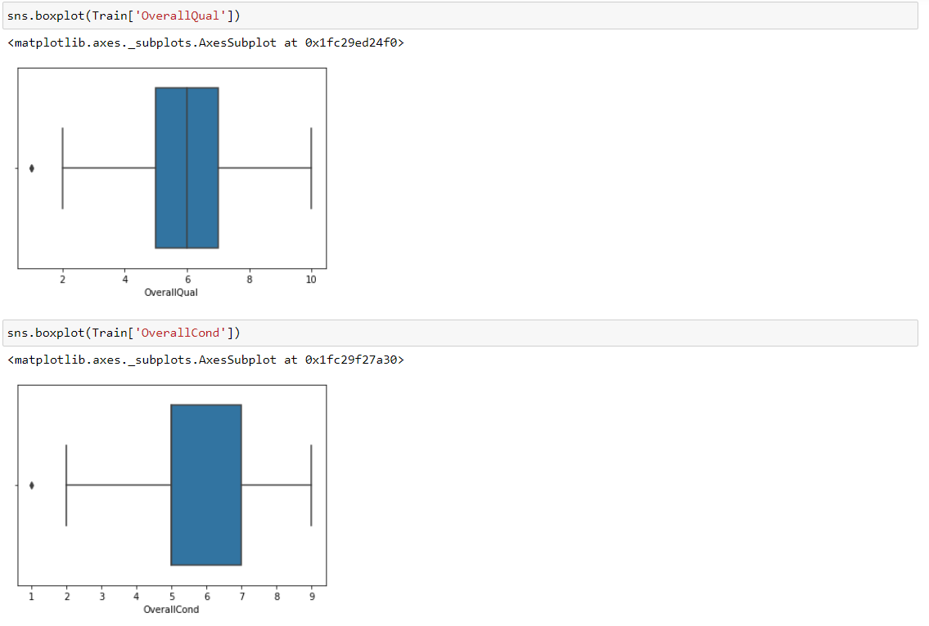
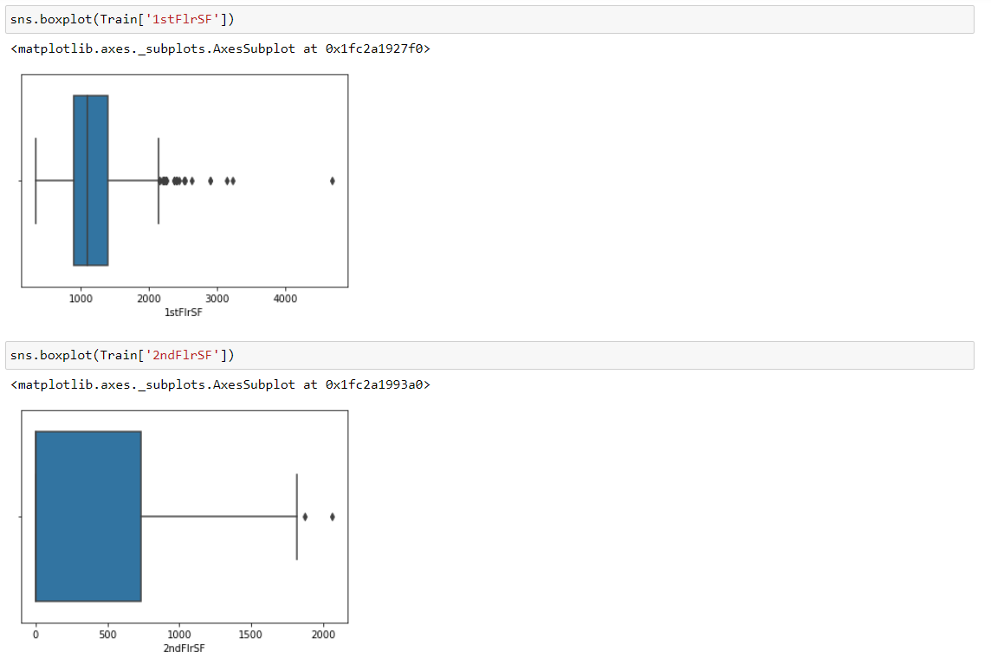
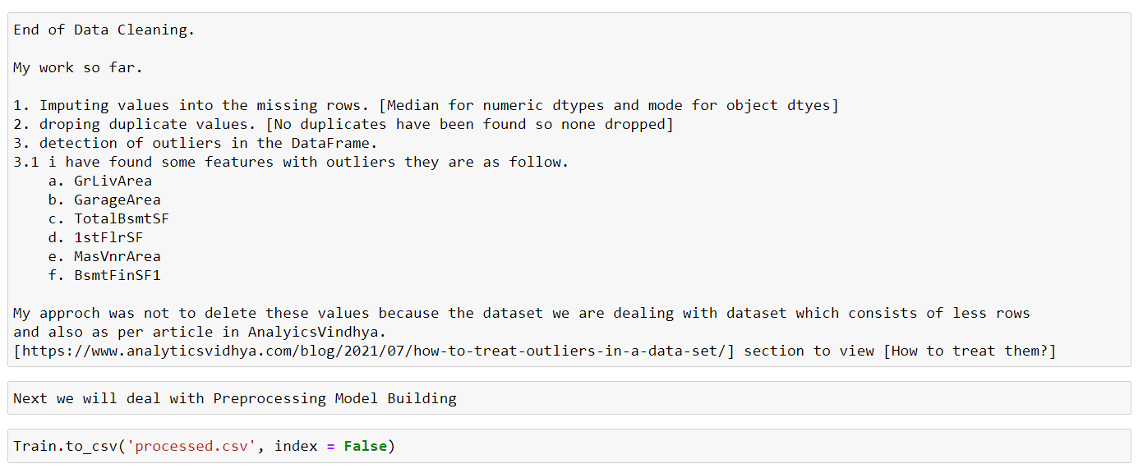
Outliers Detection
Visit my notebook to view outlier.

Slide 12
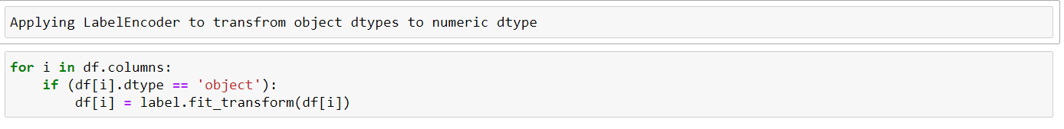
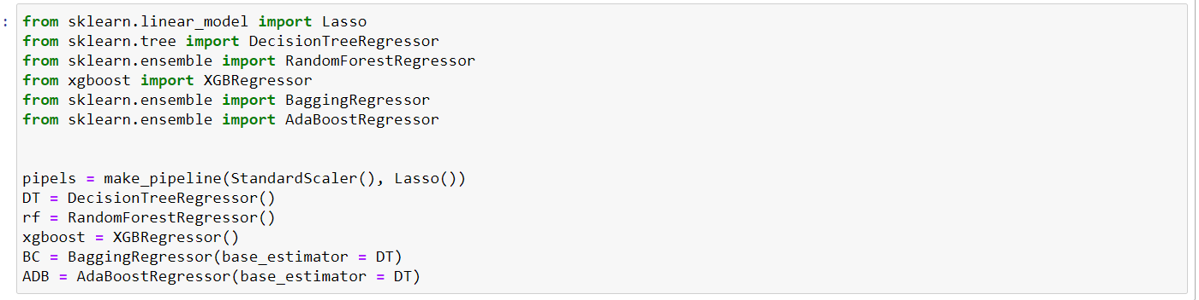
Step 4:
Data Preprocessing
Step 5:
Model Building

Slide 13
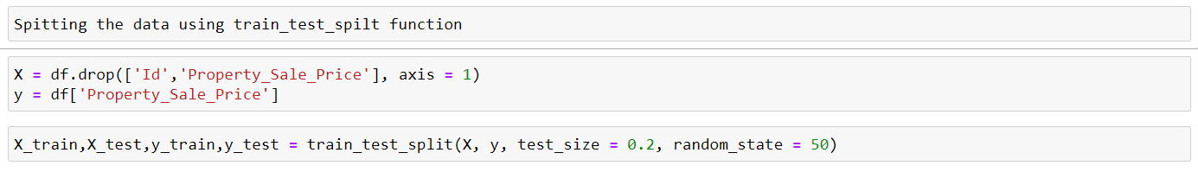
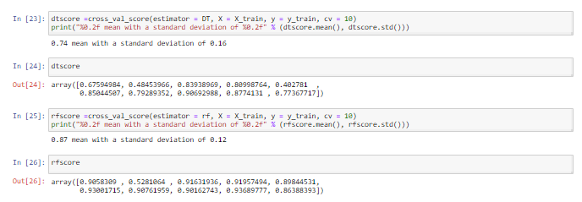
Data Splitting
Applying Cross Validate Score to Train the Models

Slide 14
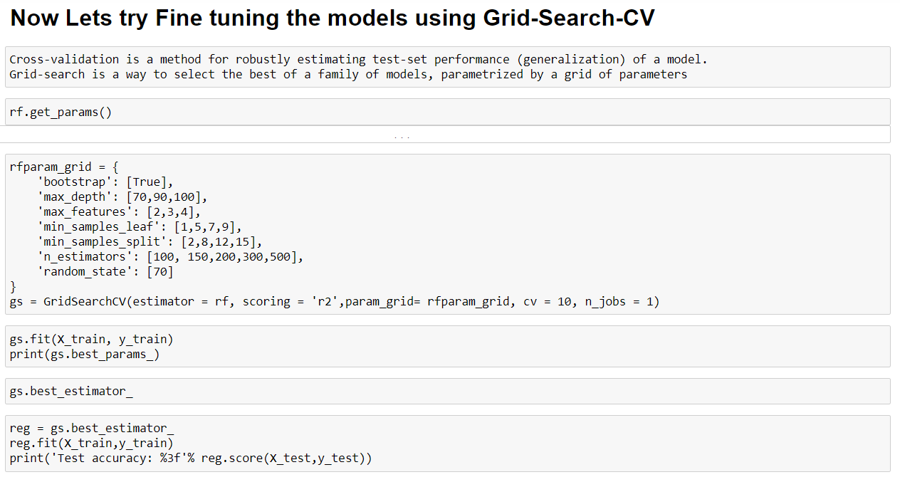
Grid Search Cv
Grid Search Cv is one of the way to improve the performance of the Models.
I tried using gridsearchcv function but notebook kept crashing

Slide 15
END NOTES
Random Forest and Adaboost Regressors have performed better compared to other Models.
So either one can be used for Prediction.
Grid Search CV function can bring out the best out of Model.

Slide 16

THANK YOU!
Kanwati
Megnath
GitHub
https://github.com/Meg-Megnath

